Slide 1
BCD ADDER

Slide 2
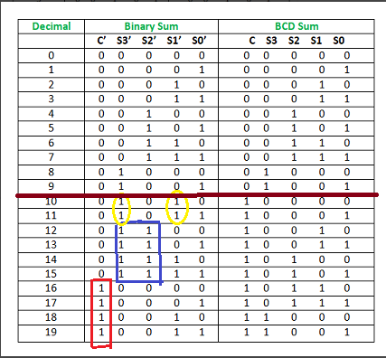
Truth Table

Slide 3
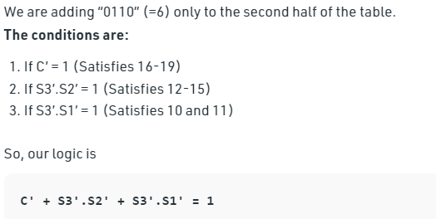
BCD ADDER

Slide 4
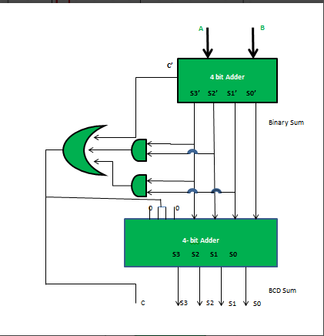
IMPLEMENTATION
Notes:
Reference: https://www.geeksforgeeks.org/bcd-adder-in-digital-logic/

Slide 5
Binary Adder-Subtractor
In Digital Circuits, A Binary Adder-Subtractor is one which is capable of both addition and subtraction of binary numbers in one circuit itself.

Slide 6
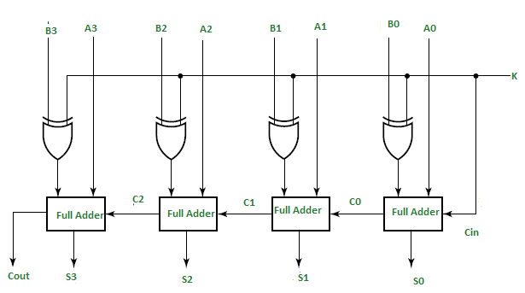
Binary Adder-Subtractor
Notes:
https://www.geeksforgeeks.org/4-bit-binary-adder-subtractor/

